Slide 1
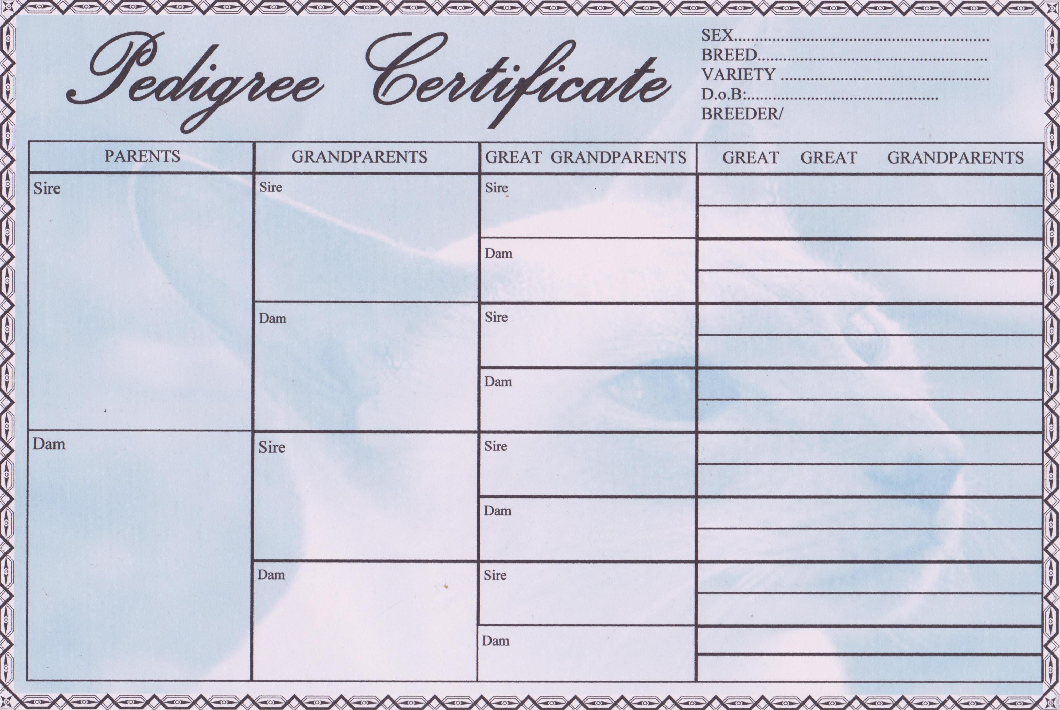
Grand Champion
Chapelrose Holy
Moses
748210 32fn
Imp Grand Champion
Chapelrose Ohmeohmy 702994
37a
Stenic justin
Timberlake 670562
Int Ch Arhantin Erlkonig of Mariol’s 24a
Applejack Bedazzled 24fn
GR CH Shadowsquad Gabriel 37
Shadowsquad Wedding belle 38b
Shadowsquad Kenya 24b
Sensual Dancing Dawn 24c
CH Cazzywoods Armageddon 37k
GR CH&GR PR Solarus Stargalaxy 37y
Shadowsquad
Constantine 667040
Toghar Cinshashi
709851 37m
Champion adviam
Shadowsquad nairobi
Solarus Jeangenie
630053
Adeciam
Madambelle
768010 24a
Adfuram
Caramac lad
574685 24a
Adivelam Harvey
Moon 385508 24
Adveram yoss orian
435445 24a
Whojoe Hazim
568573 24
Adfuram crystal dream
595513 24
Jarvey 24
Adouzam weihiachten 24b
Jayomi barbadian boy 24
|tyjanmeek 24
Adwelam Shohin 24
Whojoe pamema 29
Advenam coffee toffee 24
Adtream Lucy of Diamonds 24b
Sweetstef Heavenly Delight
737129 24

